Slide 1
Software Engineering: A Practitioner’s Approach, 7/e
Chapter 3
Agile Development copyright © 1996, 2001, 2005
R.S. Pressman & Associates, Inc.
For University Use Only
May be reproduced ONLY for student use at the university level when used in conjunction with Software Engineering: A Practitioner's Approach.
Any other reproduction or use is expressly prohibited.
Coming up: The Manifesto for
Agile Software Development

Slide 2
The Manifesto for
Agile Software Development
“We are uncovering better ways of developing software by doing it and helping others do it. Through this work we have come to value:
  Individuals and interactions over processes and tools
  Working software over comprehensive documentation
  Customer collaboration over contract negotiation
  Responding to change over following a plan
That is, while there is value in the items on the right, we value the items on the left more.”
agilemanifesto.org
Kent Beck et al
Coming up: What is “Agility”?

Slide 3
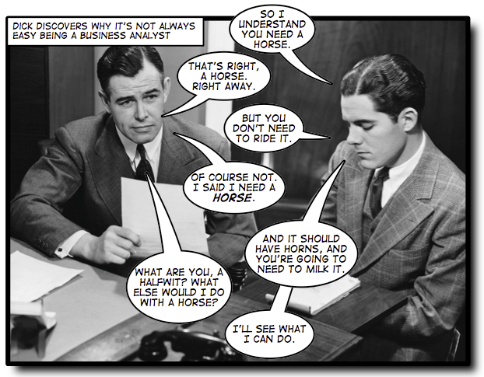
What is “Agility”?
Effective (rapid and adaptive) response to change
Effective communication among all stakeholders
Drawing the customer onto the team
Organizing a team so that it is
in control of the work
performed
Yielding …
Rapid, incremental delivery of
software
Coming up: An Agile Process

Slide 4
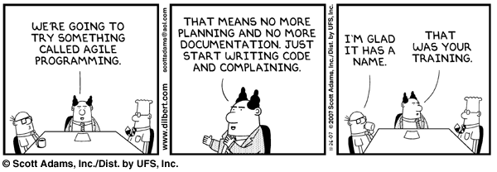
An Agile Process
Is driven by customer descriptions of what is required (scenarios)
Recognizes that plans are short-lived
Develops software iteratively with a heavy emphasis on construction activities
Delivers multiple ‘software increments’
Adapts as
changes
occur
Coming up: Extreme Programming (XP)

Slide 5
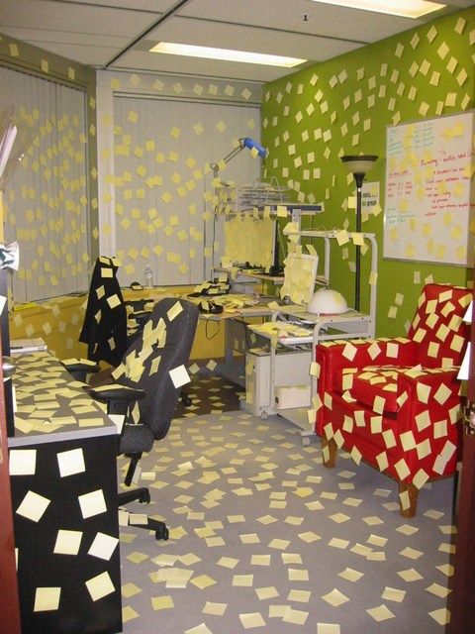
Extreme Programming (XP)
The second most widely used agile process, originally proposed by Kent Beck
XP Planning
  Begins with the creation of “user stories”
  Agile team assesses each story and assigns a
  cost
  Stories are grouped to form a deliverable
  increment
  A commitment is made on delivery date
  After the first increment “project velocity” is used to help define subsequent delivery dates for other increments
Coming up: Extreme Programming (XP)

Slide 6
Extreme Programming (XP)
XP Design
  Follows the KIS principle
  Encourage the use of CRC cards (see Chapter 8)
  For difficult design problems, suggests the creation of “spike solutions”—a design prototype
  Encourages “refactoring”—an iterative refinement of the internal program design
XP Coding
  Recommends the construction of a unit test for a store before coding commences
  Encourages “pair programming”
XP Testing
  All unit tests are executed daily
  “Acceptance tests” are defined by the customer and executed to assess customer visible functionality
Coming up: Extreme Programming (XP)

Slide 7
Dynamic Systems Development Method
Promoted by the DSDM Consortium (www.dsdm.org)
DSDM—distinguishing features
  Similar in most respects to XP
  Nine guiding principles
    Active user involvement is imperative.
    DSDM teams must be empowered to make decisions.
    The focus is on frequent delivery of products.
    Fitness for business purpose is the essential criterion for acceptance of deliverables.
    Iterative and incremental development is necessary to converge on an accurate business solution.
    All changes during development are reversible. (configuration management)
    Requirements are baselined at a high level
    Testing is integrated throughout the life-cycle.
Coming up: Dynamic Systems Development Method
Notes:
Goal here is to get something “good enough” because 80% of functionality is done with 20% of requirements. Emphasis on avoiding perfection… just “good enough”
Popular in UK

Slide 8
DSDM
An agile approach
A focus on frequent delivery of products
  deliver something "good enough" earlier is always better than to deliver everything "perfectly" in the end
When should we not use it?
  Cases where there is no “good enough”
    ultradependable/safety critical software
    What else?
These courseware materials are to be used in conjunction with Software Engineering: A Practitioner’s Approach, 6/e and are provided with permission by R.S. Pressman & Associates, Inc., copyright © 1996, 2001, 2005

Slide 9
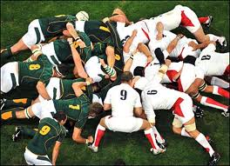
Scrum
Originally proposed by Schwaber and
Beedle
Scrum—distinguishing features
  Development work is partitioned into “packets”
  Testing and documentation are on-going as the product is constructed
  Work occurs in “sprints” and is derived from a “backlog” of existing requirements
  Meetings are very short and sometimes conducted without chairs
  “demos” are delivered to the customer with the time-box allocated
Currently seems to have overtaken XP as most popular
Coming up: Scrum

Slide 10
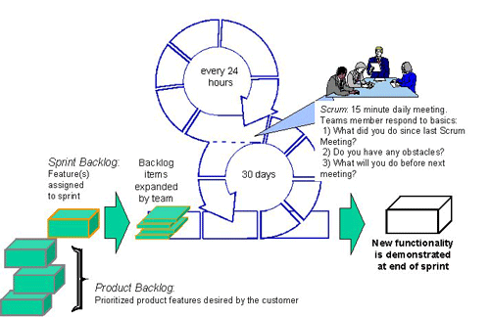
Scrum
Coming up: Others

Slide 11
Agile Idea
Frequent idea: Fix time, not features
Functionality
FIXED
Time
Resources
Agile
Prescriptive
Time
Resources
VARIABLE
Functionality

Slide 12
Criticisms
Lack of structure and necessary documentation
Only works with senior-level developers
Incorporates insufficient software design
Requires meetings at frequent intervals at enormous expense to customers
Requires too much cultural change to adopt
Can lead to more difficult contractual negotiations
Can be very inefficient— maybe code things multiple times as they change if the requirements for one area of code change through various iterations, the same programming may need to be done several times over. Whereas if a plan were there to be followed, a single area of code is expected to be written once.
Hard to develop realistic estimates of work effort because at the beginning of the project no one knows the entire scope/requirements
Agile is feature driven, non-functional quality attributes are hard to be placed as user stories
Can increase the risk of scope creep due to lack of detailed requirements
Source: Wikipedia

